Slide 1
Lecture 7
DTMC – First Passage Times and Absorption States

Slide 2
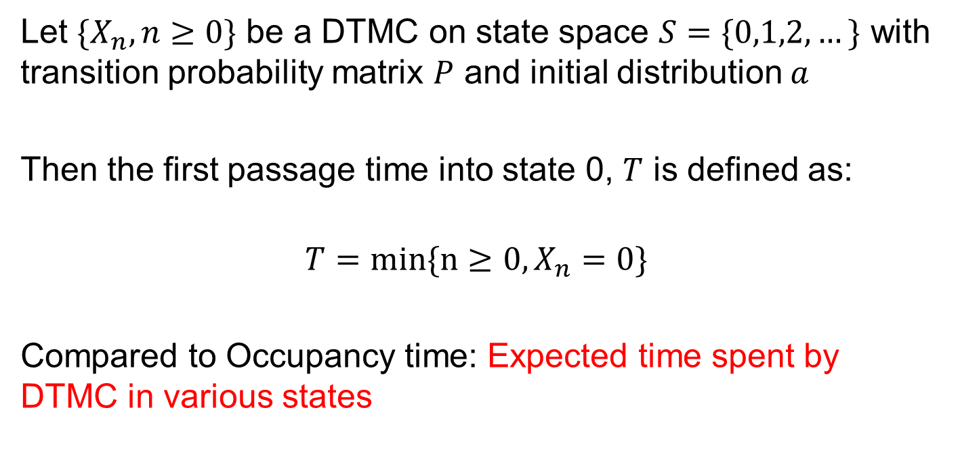
First Passage Time
Let $\{X_{n},n≥0\}$ be a DTMC on state space $S=\{0,1,2,…\}$ with transition probability matrix $P$ and initial distribution $a$
Then the first passage time into state 0, $T$ is defined as:
$$T=min\{n≥0,X_{n}=0\}$$
Compared to Occupancy time: Expected time spent by DTMC in various states

Slide 3
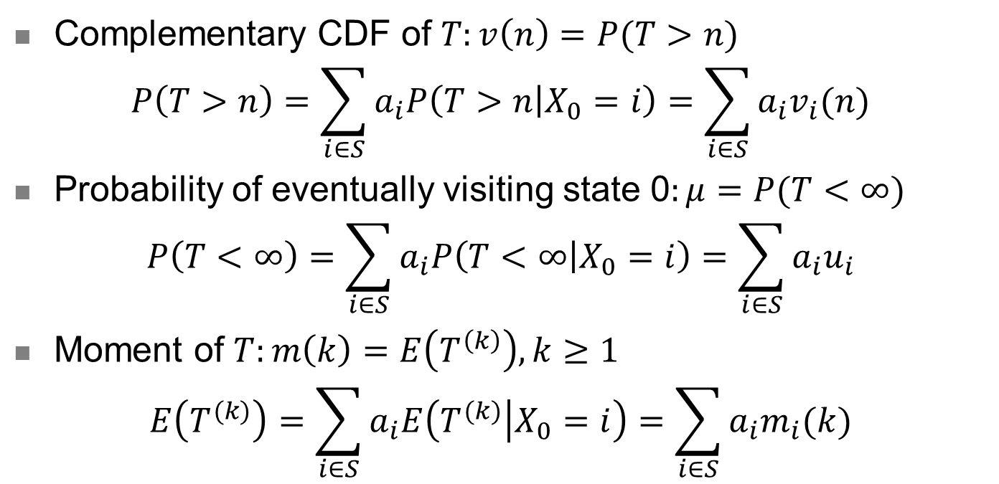
First Passage Time - Elements
Complementary CDF of $T:v\left(n\right)=P(T>n)$
$$P\left(T>n\right)=\sum_{i∈S}{a_{i}P\left(T>n | X_{0}=i\right)=\sum_{i∈S}{a_{i}v_{i}(n)}}$$
Probability of eventually visiting state 0$:μ=P(T<∞)$
$$P\left(T<∞\right)=\sum_{i∈S}{a_{i}P\left(T<∞ | X_{0}=i\right)=\sum_{i∈S}{a_{i}u_{i}}}$$
Moment of $T:m\left(k\right)=E\left(T^{\left(k\right)}\right), k≥1$
$$E\left(T^{(k)}\right)=\sum_{i∈S}{a_{i}E\left(T^{(k)} | X_{0}=i\right)=\sum_{i∈S}{a_{i}m_{i}(k)}}$$

Slide 4
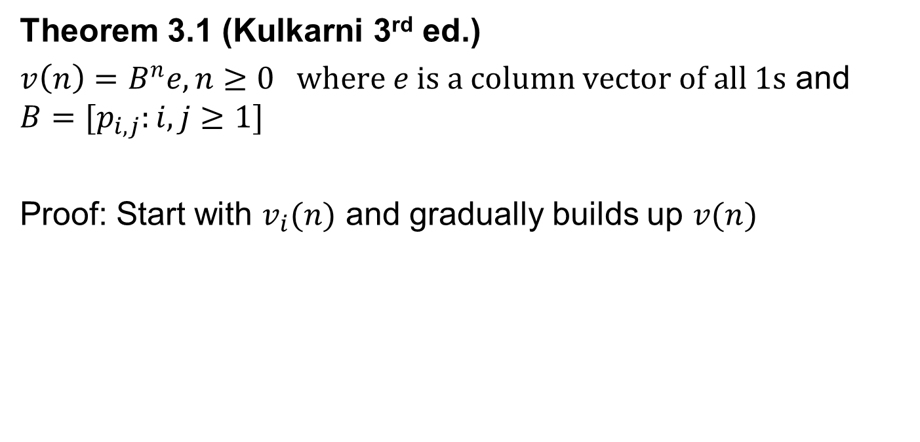

Complementary CDF $v(n)$
Theorem 3.1 (Kulkarni 3rd ed.)
$v\left(n\right)=B^{n}e, n≥0 where e is a column vector of all 1s$ and $B=[p_{i,j}:i,j≥1]$
Proof: Start with $v_{i}(n)$ and gradually builds up $v(n)$

Slide 5
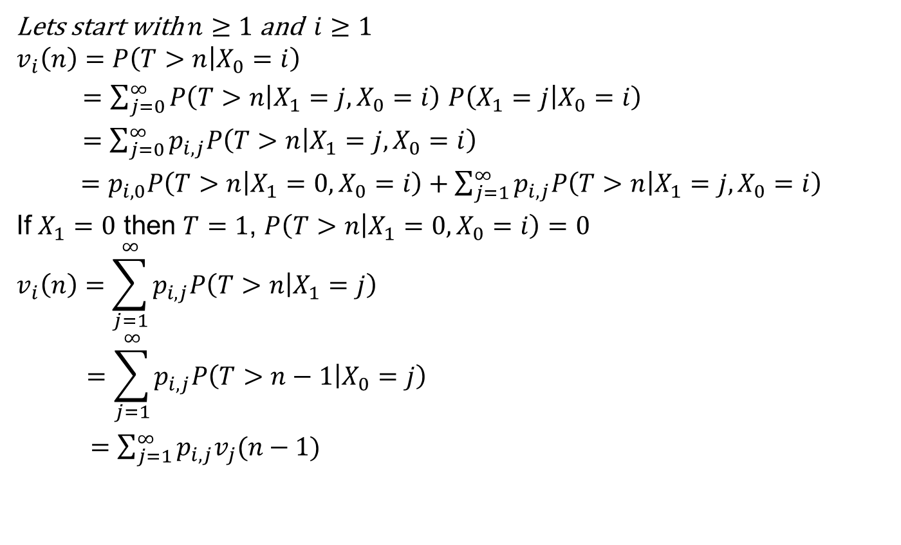
Theorem 3.1 (Kulkarni 3rd ed.)
Lets start with $n≥1$ and $i≥1$
$$v_{i}\left(n\right)=P\left(T>n | X_{0}=i\right)$$
$=\sum_{j=0}^{∞}{P\left(T>n | {X_{1}=j,X}_{0}=i\right)}$ $P\left(X_{1}=j | X_{0}=i\right)$
$=\sum_{j=0}^{∞}{p_{i,j}P\left(T>n | {X_{1}=j,X}_{0}=i\right)}$
$=p_{i,0}P\left(T>n | {X_{1}=0,X}_{0}=i\right)+\sum_{j=1}^{∞}{p_{i,j}P\left(T>n | {X_{1}=j,X}_{0}=i\right)}$
If $X_{1}=0$ then $T=1$, $P\left(T>n | {X_{1}=0,X}_{0}=i\right)=0$
$$v_{i}\left(n\right)=\sum_{j=1}^{∞}{p_{i,j}P\left(T>n | X_{1}=j\right)}$$
$$=\sum_{j=1}^{∞}{p_{i,j}P\left(T>n−1 | X_{0}=j\right)}$$
$=\sum_{j=1}^{∞}{p_{i,j}v_{j}(n−1)}$

Slide 6
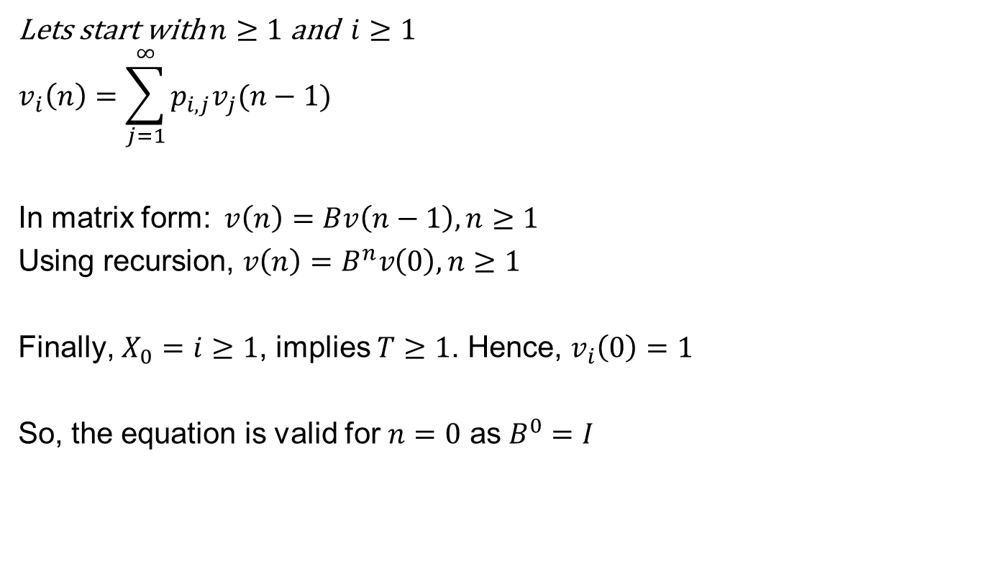
Theorem 3.1 (Kulkarni 3rd ed.)
Lets start with $n≥1$ and $i≥1$
$$v_{i}\left(n\right)=\sum_{j=1}^{∞}{p_{i,j}v_{j}(n−1)}$$
In matrix form: $v\left(n\right)=Bv\left(n−1\right), n≥1$
Using recursion, $v\left(n\right)=B^{n}v\left(0\right), n≥1$
Finally, $X_{0}=i≥1$, implies $T≥1$. Hence, $v_{i}\left(0\right)=1$
So, the equation is valid for $n=0$ as $B^{0}=I$

Slide 7
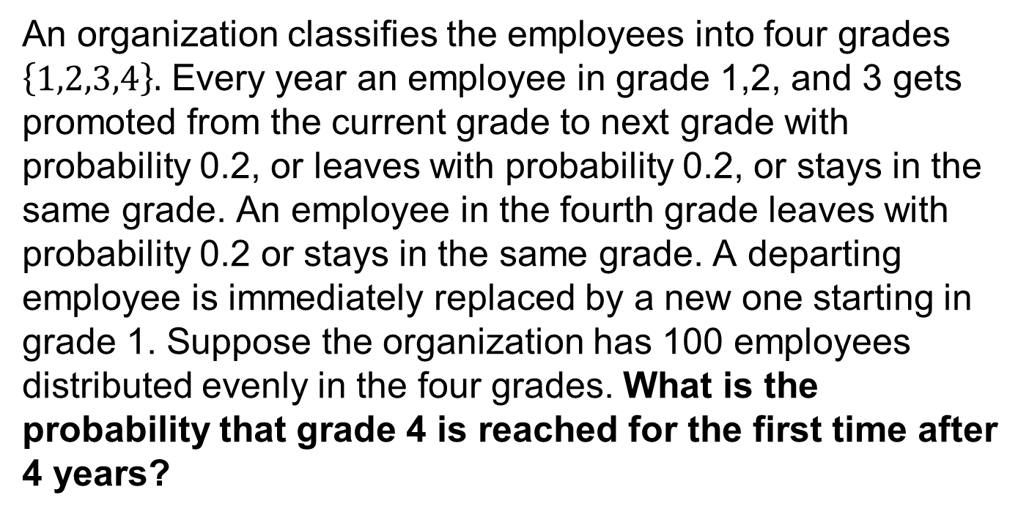
Example 2.23 (Kulkarni 3rd ed) Revisited
An organization classifies the employees into four grades $\left\{1,2,3,4\right\}.$ Every year an employee in grade 1,2, and 3 gets promoted from the current grade to next grade with probability 0.2, or leaves with probability 0.2, or stays in the same grade. An employee in the fourth grade leaves with probability 0.2 or stays in the same grade. A departing employee is immediately replaced by a new one starting in grade 1. Suppose the organization has 100 employees distributed evenly in the four grades. What is the probability that grade 4 is reached for the first time after 4 years?

Slide 8

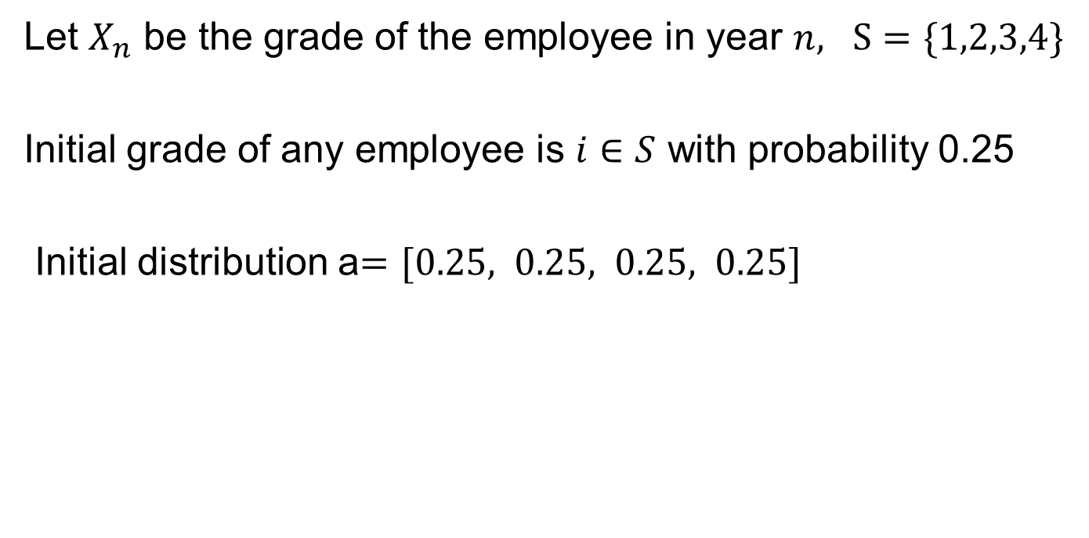
Example 2.23 – Solution Hint
Let $X_{n}$ be the grade of the employee in year $n, S=\{1,2,3,4\}$
Initial grade of any employee is $i∈S$ with probability 0.25
Initial distribution a$=[0.25, 0.25, 0.25, 0.25]$
0.8 0.2 0.0 0.0
0.2 0.6 0.2 0.0
0.2 0.0 0.6 0.2
0.2 0.0 0.0 0.8
$$P=$$

Slide 9

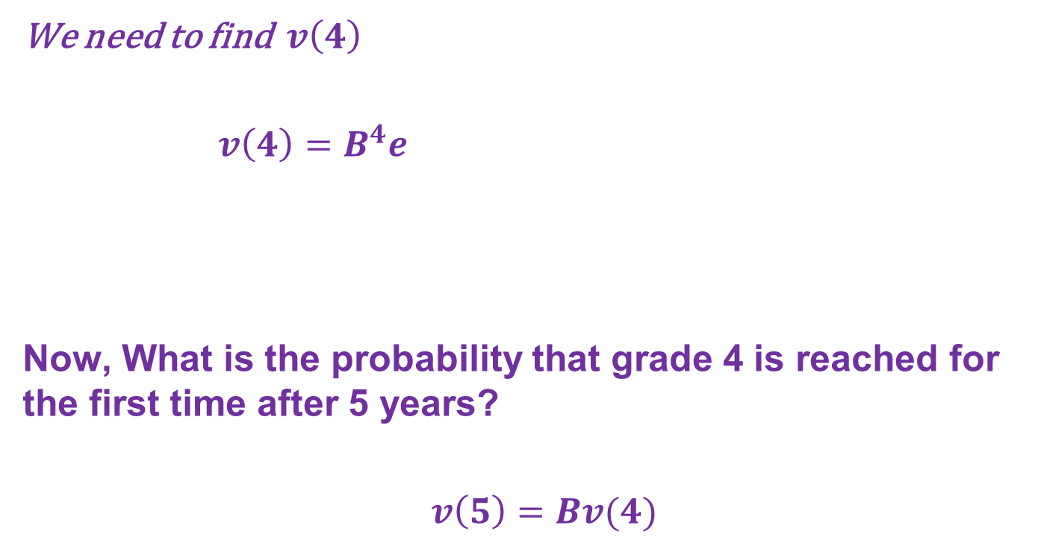

Example 2.23 – Solution Hint
We need to find $v\left(4\right)$
$v\left(4\right)=B^{4}e$
Now, What is the probability that grade 4 is reached for the first time after 5 years?
$v\left(5\right)=Bv(4)$
0.8 0.2 0.0 0.0
0.2 0.6 0.2 0.0
0.2 0.0 0.6 0.2
0.2 0.0 0.0 0.8
$$B$$
$$P=$$

Slide 10
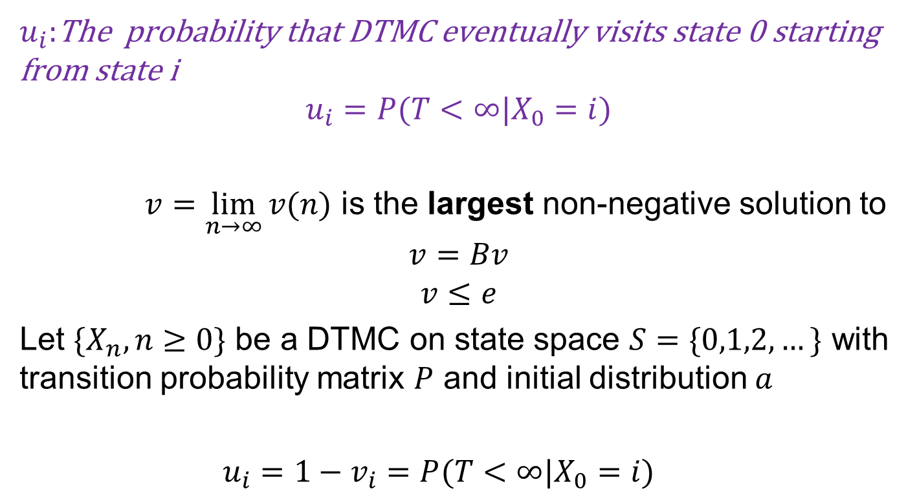
Absorption Probabilities
$u_{i}:$The probability that DTMC eventually visits state 0 starting from state i
$$u_{i}=P(T<∞|X_{0}=i)$$
$v=\lim_{n→∞}{v(n)}$ is the largest non-negative solution to
$$v=Bv$$
$$v≤e$$
Let $\{X_{n},n≥0\}$ be a DTMC on state space $S=\{0,1,2,…\}$ with transition probability matrix $P$ and initial distribution $a$
$u_{i}=1−v_{i}=P(T<∞|X_{0}=i)$

Slide 11

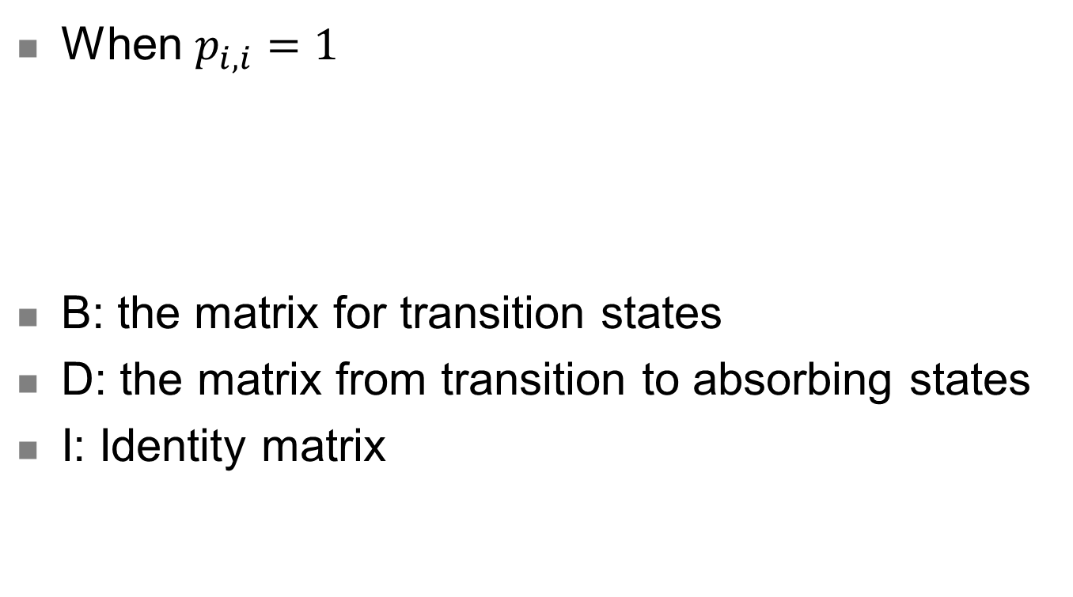
Special Case
When $p_{i,i}=1$
B: the matrix for transition states
D: the matrix from transition to absorbing states
I: Identity matrix
B D
0 I
$$P=$$

Slide 12

Example
Consider an example with 2 computers. Computer repair process has 3 states
0 (No computers have failed)
1 (One computer failed)
2 (Both computers failed)
Transition Matrix is given by:
0.6 0.3 0.1
0.8 0.2 0
0 0 1
$$P=$$

Slide 13
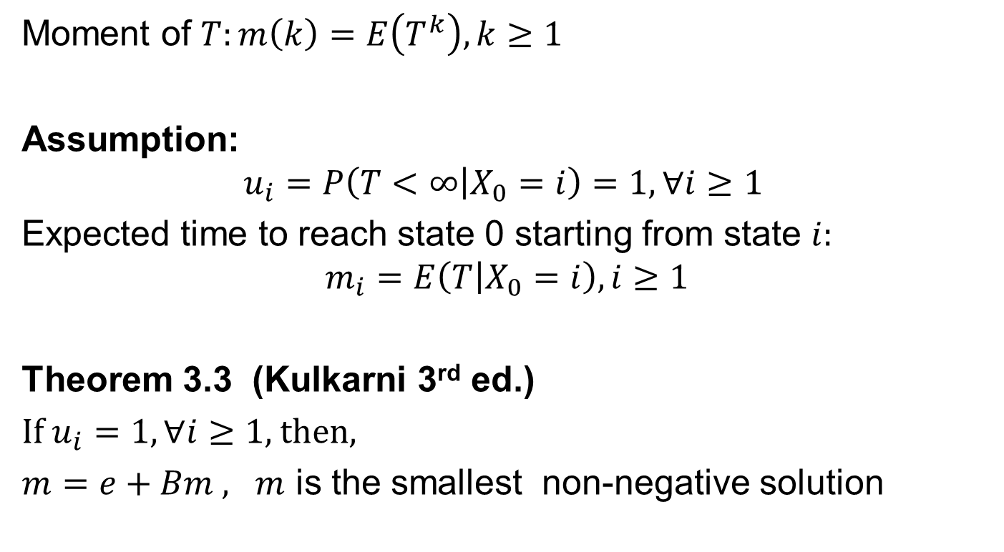

Moment of First Passage Time $m(k)$
Moment of $T:m\left(k\right)=E\left(T^{k}\right), k≥1$
Assumption:
$$u_{i}=P\left(T<∞ | X_{0}=i\right)=1, ∀i≥1$$
Expected time to reach state 0 starting from state $i:$
$$m_{i}=E\left(T | X_{0}=i\right), i≥1$$
Theorem 3.3 (Kulkarni 3rd ed.)
If $u_{i}=1,∀i≥1,$then,
$m=e+Bm , m$ is the smallest non-negative solution

Slide 14
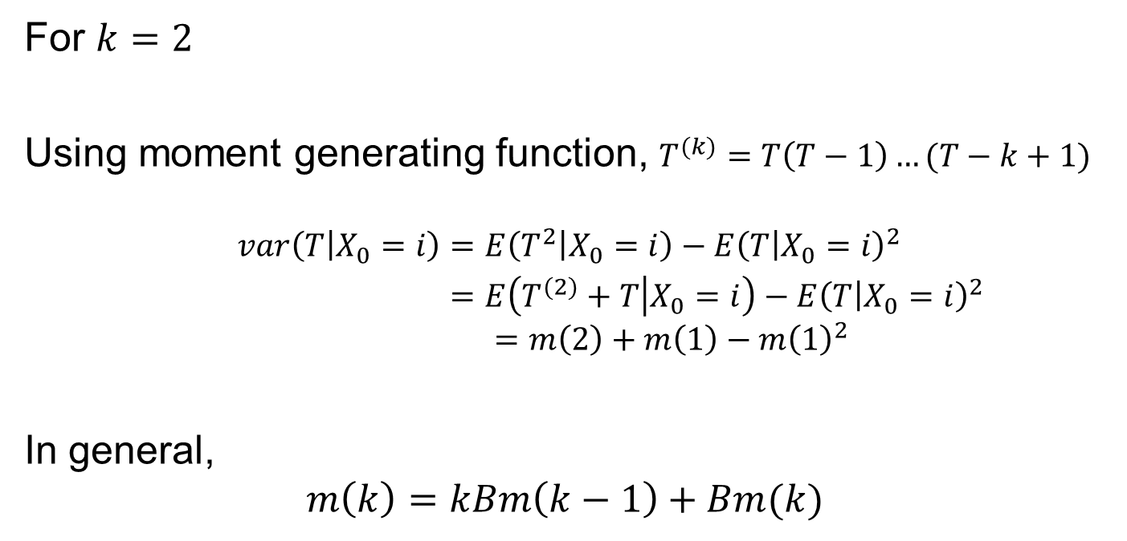
Moment of First Passage Time $m(k)$
For $k=2$
Using moment generating function, $T^{(k)}=T\left(T−1\right)…(T−k+1)$
$$var\left(T | X_{0}=i\right)=E\left(T^{2} | X_{0}=i\right)−E{\left(T | X_{0}=i\right)}^{2}$$
$=E\left(T^{(2)}+T | X_{0}=i\right)−E{\left(T | X_{0}=i\right)}^{2}$
$$=m\left(2\right)+m\left(1\right)−m{\left(1\right)}^{2}$$
In general,
$$m\left(k\right)=kBm\left(k−1\right)+Bm(k)$$

Slide 15


Example
Let $\{X_{n},n≥0\}$ be a DTMC on state space $S=\{0,1,2,3\}$ with transition probability matrix $P$
Let $T=min\{n≥0:X_{n}=0\}$
0.2 0.1 0.0 0.7
0.1 0.3 0.6 0.0
0.0 0.4 0.2 0.4
0.7 0.0 0.1 0.2
$$P=$$

Slide 16



Example – Question (a)
(a) $P(T≥3|X_{0}=1)$
$$P(T>2|X_{0}=1)$$
$$=v_{1}\left(2\right)$$
$$=B^{2}e$$
0.2 0.1 0.0 0.7
0.1 0.3 0.6 0.0
0.0 0.4 0.2 0.4
0.7 0.0 0.1 0.2
$$P=$$
$$B$$

Slide 17

Example – Question (b)
(b) $E(T|X_{0}=1)$
$$m(1)={\left(I−B\right)}^{−1}e$$
$$E\left(T | X_{0}=1\right)=m_{1}(1)$$
0.2 0.1 0.0 0.7
0.1 0.3 0.6 0.0
0.0 0.4 0.2 0.4
0.7 0.0 0.1 0.2
$$P=$$
$$B$$

Slide 18

Example – Question (c)
(b) $var(T|X_{0}=1)$
$$m\left(2\right)=2{\left(I−B\right)}^{−1}Bm\left(1\right)$$
$$var\left(T | X_{0}=1\right)=m_{1}\left(2\right)+m_{1}\left(1\right)−m_{1}{\left(1\right)}^{2}$$
0.2 0.1 0.0 0.7
0.1 0.3 0.6 0.0
0.0 0.4 0.2 0.4
0.7 0.0 0.1 0.2
$$P=$$
$$B$$

Slide 19
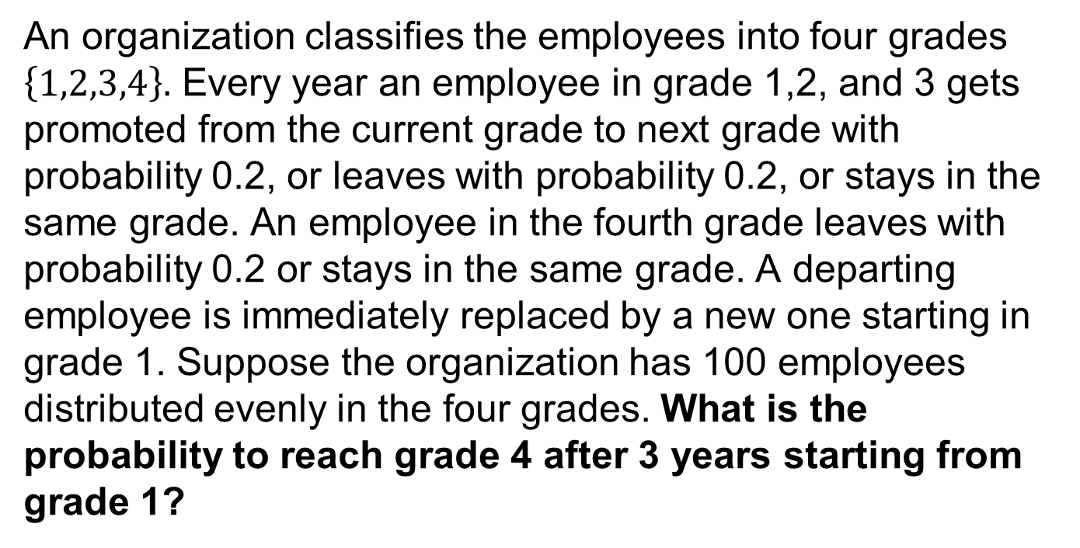
Example 2.23 (Kulkarni 3rd ed) Revisited
An organization classifies the employees into four grades $\left\{1,2,3,4\right\}.$ Every year an employee in grade 1,2, and 3 gets promoted from the current grade to next grade with probability 0.2, or leaves with probability 0.2, or stays in the same grade. An employee in the fourth grade leaves with probability 0.2 or stays in the same grade. A departing employee is immediately replaced by a new one starting in grade 1. Suppose the organization has 100 employees distributed evenly in the four grades. What is the probability to reach grade 4 after 3 years starting from grade 1?

Slide 20


Example 2.23 – Solution Hint
Let $X_{n}$ be the grade of the employee in year $n, S=\{1,2,3,4\}$
Initial grade of any employee is $i∈S$ with probability 0.25
Initial distribution a$=[0.25, 0.25, 0.25, 0.25]$
0.8 0.2 0.0 0.0
0.2 0.6 0.2 0.0
0.2 0.0 0.6 0.2
0.2 0.0 0.0 0.8
$$B$$
$$P(T>2|X_{0}=1)$$
$$=v_{1}\left(2\right)$$
$$=B^{2}e$$
$$P=$$

